Slide 1
Reinforcement Learning (Chapter 22)
Dr. Shengquan Wang
Most slides are adopted from
Artificial Intelligence: A Modern Approach, 4th ed. by Stuart Russell (UC Berkeley) and Peter Norvig (Google).
Dan Klein and Pieter Abbeel for CS188 Intro to AI at UC Berkeley.
Peter Norvig and Sebastian Thrun for Intro to Artificial Intelligence at Udacity.
Sutton, Richard S., and Andrew G. Barto. Reinforcement learning: An introduction.

Slide 2
Outline
Introduction

Slide 3
Roadmap
By far: reasoning/planning with the known model.
The rest: learn a model from the data (machine learning)
MDP (Markov Decision Problem)
Reinforcement Learning
Notes:
Extra step necessary with reinforcement learning: determine/model the transition model and the utility model using data sampling.
Step 1) find the transition model.
Step 2) use MDP process to find optimal policy.

Slide 4

Review: MDP Grid World
State reward function: R(s)
Absorbing state: +100, -100
Others: -1
Markovian Transition model: P(s’|s, a) for Action a
Front: 0.8
Left: 0.1
Right: 0.1
Exception: bounced back by wall/obstacles.
-1 | -1 | -1 | +100
-1 |  | -1 | -100
-1 | -1 | -1 | -1
0.8
0.1
↑
0.1
0.1
↑
0.8
0.1
Notes:
Notice: reward (utility) and transition probability (model) is all given. With reinforcement learning we need to learn these first before using MDP process.

Slide 5
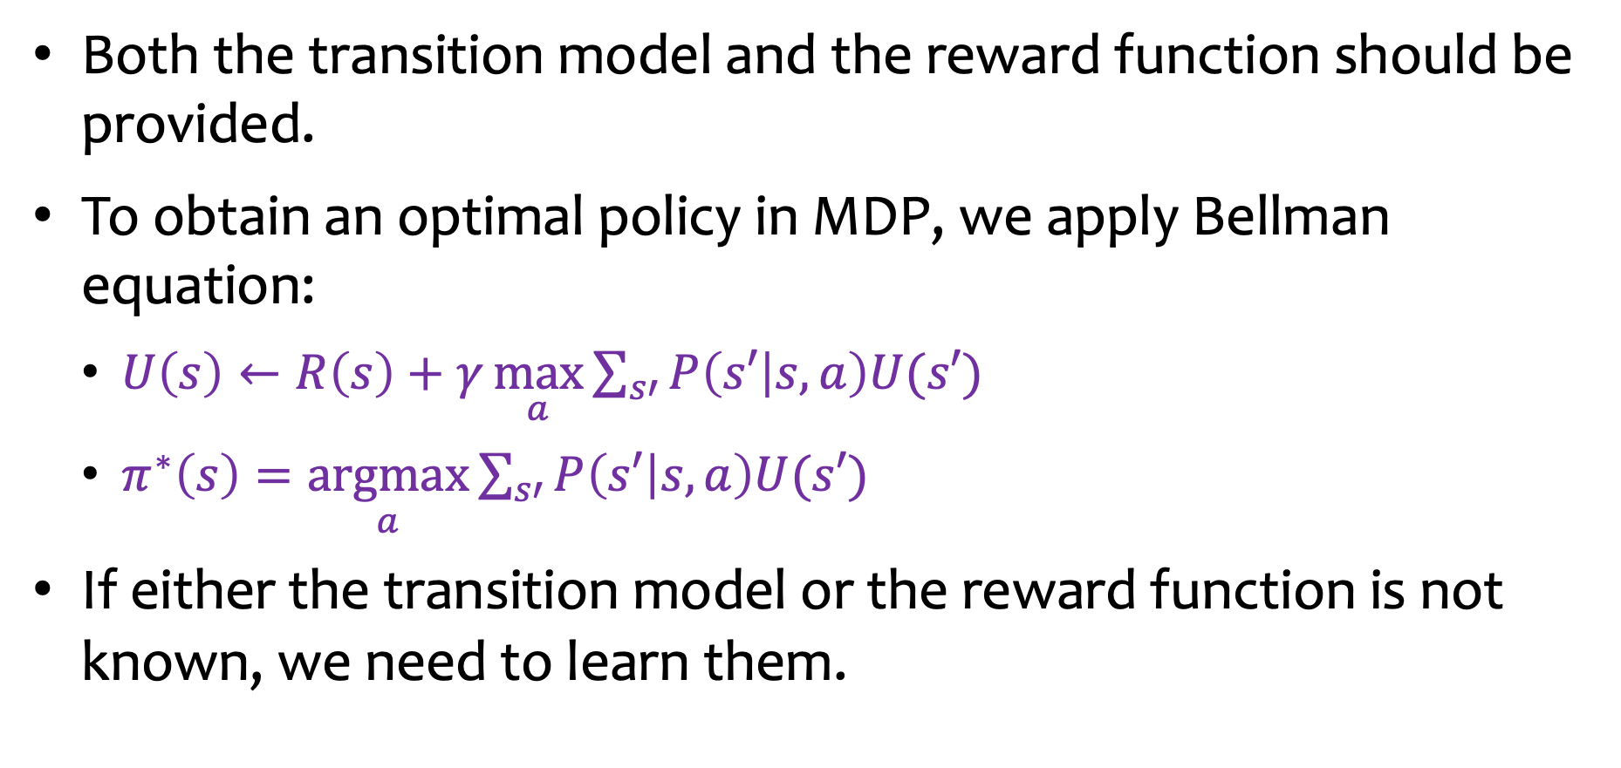
Assumptions of MDP
Both the transition model and the reward function should be provided.
To obtain an optimal policy in MDP, we apply Bellman equation:
$U\left(s\right)←R\left(s\right)+γ\underset{a}{\text{max}}{\sum_{s′}{P\left(s′ | s,a\right)U(s′)}}$
$π^{∗}\left(s\right)=\underset{a}{\text{arg}\text{max}}{\sum_{s′}{P\left(s′ | s,a\right)U(s′)}}$
If either the transition model or the reward function is not known, we need to learn them.

Slide 6
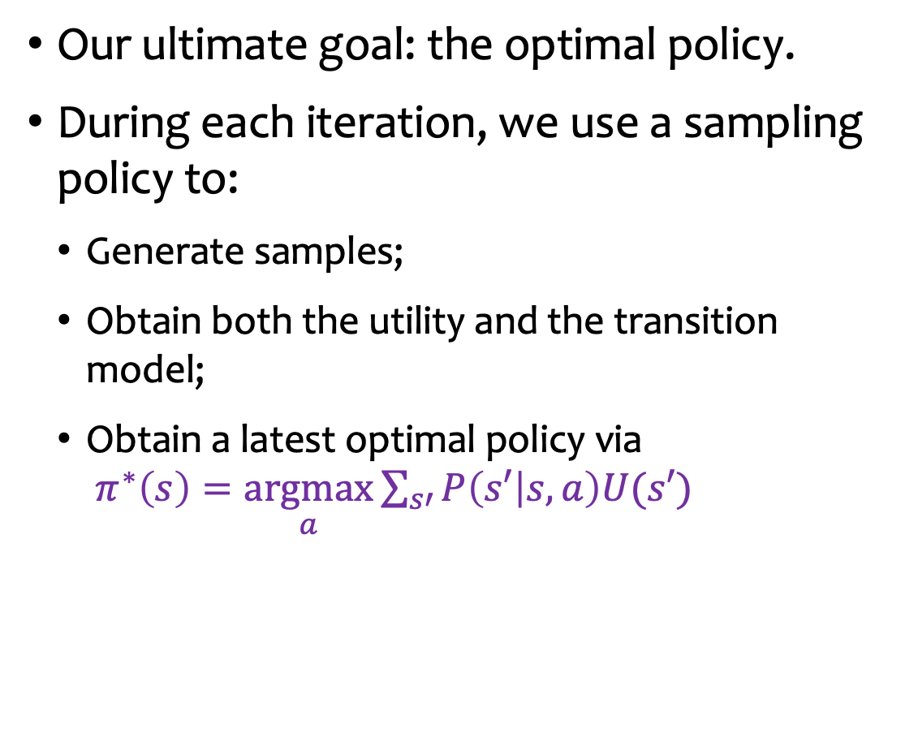
Reinforcement Learning (RL)
Our ultimate goal: the optimal policy.
During each iteration, we use a sampling policy to:
Generate samples;
Obtain both the utility and the transition model;
Obtain a latest optimal policy via $π^{∗}\left(s\right)=\underset{a}{\text{argmax}}{\sum_{s′}{P\left(s′ | s,a\right)U(s′)}}$
Sampling policy
Transition model and Utility
Latest optimal policy
Notes:
Remember: a set action for all states = the policy.
Sampling policy = choose action for all states to get a policy and record the data for that policy = the sample.
Remember: objective is to find the best action at each state.
Preferable: sample a policy using the currently best-known (latest) action from previous sampling results.

Slide 7
Reinforcement Learning vs Policy Iteration
Sampling policy
New policy
Transition model and Utility
Policy evaluation
Latest optimal policy
Policy improvement
Notes:
Policy iteration: we already have the transition model
Reinforcement mode: we do not already have the transition model (probabilities and costs).

Slide 8
Three Tasks in RL
How to choose sampling policies?
How to learn transition model and the utility from samples?
How to obtain the optimal policy?
Sampling policy
Transition model and Utility
Latest optimal policy

Slide 9
Outline
Introduction
Exploitation and Exploration

Slide 10
Exploitation and Exploration
Find a dining place?
Usual Dining Place
Grand Opening
Notes:
Grand opening = more risky, since we have no data on it.

Slide 11
Multi-Armed Bandit Problem
Imagine you are facing multiple (10) slot machines and each is configured with an unknown probability of how likely you can get a reward at one play.
Question: What is the best strategy to achieve highest long-term rewards?
Reward
Slot machines
Notes:
10 slot machines.

Slide 12
Random Approach
We choose random walk as the sampling policy.
It converges very slowly (so you would pay out a lot along the way):
The goal is to find the optimal policy.
Many samples which don’t contribute the optimal policy are wasted.

Slide 13
Greedy Approach
We use the latest optimal policy as the sampling policy.
It converges faster than the random approach.
It seldom converges to the optimal policy.
The early optimal policy by the greedy approach carries strong bias.
The early-learned model is not the same as the true environment.

Slide 14
Trade-off
Exploitation by greedy approach
to maximize its utility - as reflected in its current utility estimates.
Exploration by random approach
to maximize its long-term well-being.
Notes:
Combine both:
Start off using only random (exploration) approach
As you approach some convergence, reduce random approach and implement exploitation (greedy) approach.
Gradually increase exploitation and decrease exploration
This is called E-Greedy approach.

Slide 15
ε-Greedy Approach: Combination
Choose a random action with probability ε(=1/t, t is the current time) and the greedy policy otherwise.
It will converge to an optimal policy.

Slide 16
Similar to Local Search: Simulated Annealing
Escaping local maxima by allowing downhill moves.

Slide 17
Benefit of ε-Greedy Approach
Don’t waste too much resource on sampling the actions which are not optimal actions.
Note: E-Greedy is a simple approach and easy to implement, and it is effective, but it is not the best sampling approach; there are many more advanced, complex and effective sampling approaches.

Slide 18
Three Tasks in RL
How to choose sampling policies?
How to learn the transition model and the utility from samples? → use samples
How to obtain the optimal policy?
Sampling policy
Transition model and Utility
Latest optimal policy

Slide 19
Example: A Grid World
Given a policy π:
The agent executes a set of trials in the environment using its policy π.
In each trial,
The agent starts in any state and experiences a sequence of state transitions until it reaches b4 or c4.
It generates a trajectory (from results of sampling which gives a sample policy) of (state, action, reward) until we reach absorbing (goal) state: s, a, r, s’, a’, r’, s’’, a’’, r’’, …
Task: we aim to learn the utility function U(s).
-1 | -1 | -1 | +100
-1 |  | -1 | -100
-1 | -1 | -1 | -1
c
b
a
1
2
3
4
Notes:
Once we know utility function → then we can use value iteration.

Slide 20
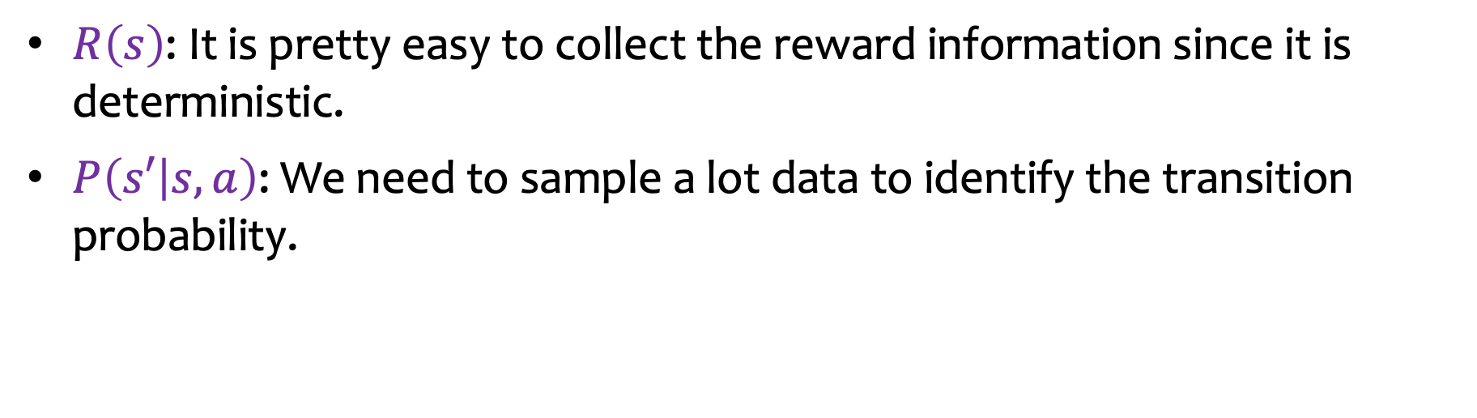
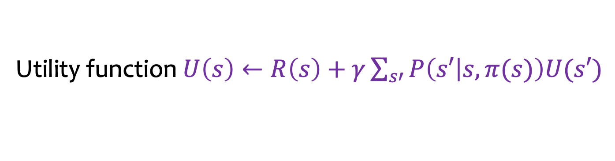
Direct Approach: Model-Based
-1 | -1 | -1 | +100
-1 |  | -1 | -100
-1 | -1 | -1 | -1
c
b
a
1
2
3
4
Utility function $U\left(s\right)←R\left(s\right)+γ\sum_{s′}{P\left(s′ | s,π(s)\right)U(s′)}$
$R\left(s\right)$: It is pretty easy to collect the reward information since it is deterministic.
$P\left(s′ | s,a\right)$: We need to sample a lot data to identify the transition probability.

Slide 21
Direct Approach: Model-Free
Problem: Model-based is too costly.
Question: Can we obtain the utility without the transition model?
Answer: Yes!
-1 | -1 | -1 | +100
-1 |  | -1 | -100
-1 | -1 | -1 | -1
c
b
a
1
2
3
4

Slide 22
Outline
Introduction
Exploitation and Exploration
Model-Free Utility Learning (saves space and time)
Using sampling, simply find expected utility of a stochastic state sequence starting at a given state → if we do this for all states, then we have effectively found the transition model!
Note: for samples at a given state, we can use parts of other samples from other starting states as part of the samples for the states that are along that trajectory (sample).

Slide 23
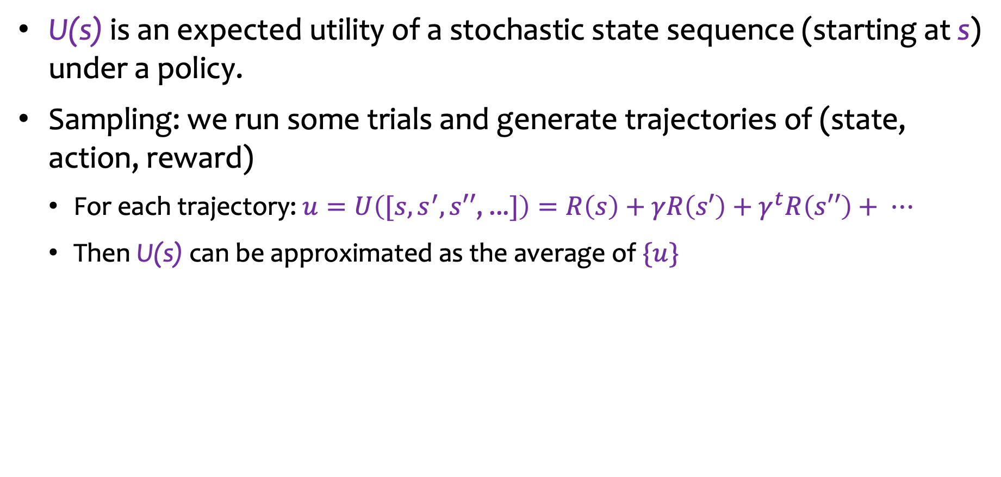
Recall: Expected Utility
U(s) is an expected utility of a stochastic state sequence (starting at s) under a policy.
Sampling: we run some trials and generate trajectories of (state, action, reward)
For each trajectory: $u=U\left([s,s^{′},s′′\text{, ...}]\right)=R\left(s\right)+γR\left(s′\right)+γ^{t}R\left(s′′\right)+ ⋯$
Then U(s) can be approximated as the average of $\{u\}$

Slide 24


Overall Mean
After running n trials with n utility values ${\{u}_{i}\}$: $U\left(s\right)= \frac{1}{n}\left(u_{1}+u_{2}\text{+}⋯\text{+}u_{n}\right)$
Drawback: we need to keep track all ${\{u}_{i}\}$ , too much memory.
Notes:
Problem: need to keep track of all trajectories in order to calculate the new average when we a new sample (trajectory) is collected.
Solution: just keep track of current mean, and total number of samples that make up that mean:
Then do: (#_samples * current average + new sample)/(#samples + 1)
This saves a lot of memory!
This is called Incremental Mean (reduce # of rows).
TD method (temporal difference method) → reduce number of columns.

Slide 25

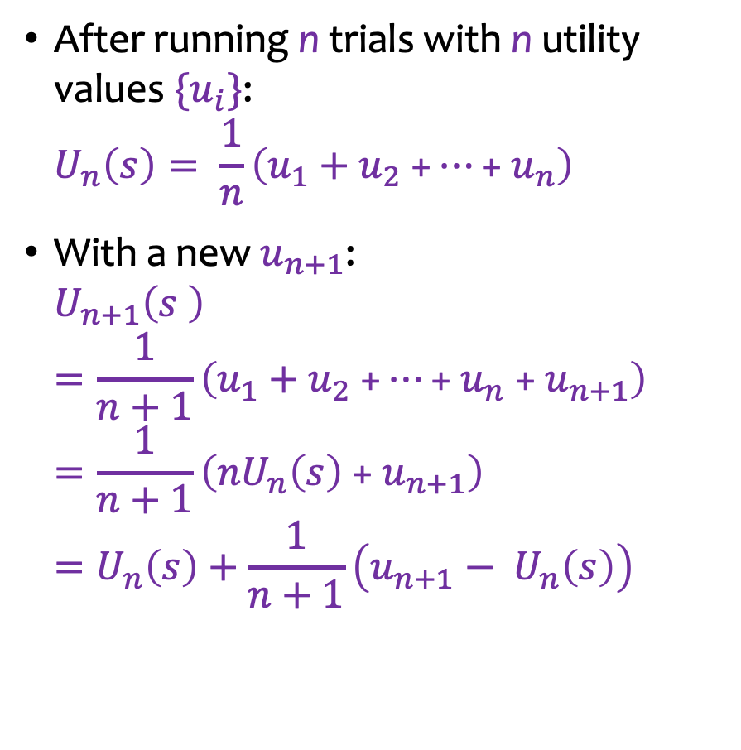
Incremental Mean
After running n trials with n utility values ${\{u}_{i}\}$: $U_{n}\left(s\right)= \frac{1}{n}\left(u_{1}+u_{2} \text{+}⋯\text{+}{ u}_{n}\right)$
With a new $u_{n+1}\text{:}$ $U_{n+1}\left(s \right)=\frac{1}{n+1}\left(u_{1}+u_{2} \text{+}⋯\text{+ }u_{n} \text{+ }u_{n+1}\right)=\frac{1}{n+1}\left({nU}_{n}\left(s\right) \text{+}{ u}_{n+1}\right)=U_{n}\left(s\right)+\frac{1}{n+1}\left({u_{n+1}− U}_{n}\left(s\right)\right)$
Incremental implementation:
$U\left(s\right)← U\left(s\right)+\frac{1}{n+1}\left(u_{n+1}−U(s)\right)$
Generalization: $U\left(s\right)←U\left(s\right)+\frac{1}{N(s)}\left(u−U(s)\right)$

Slide 26
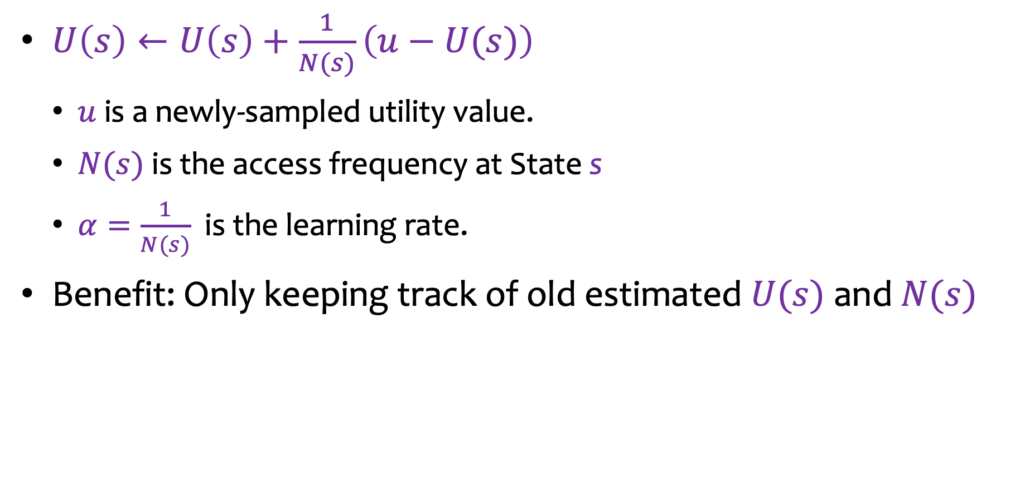

Incremental Mean (cont’d)
$U\left(s\right)←U\left(s\right)+\frac{1}{N(s)}\left(u−U(s)\right)$
$u$ is a newly-sampled utility value.
$N(s)$ is the access frequency at State s
$α=\frac{1}{N(s)}$ is the learning rate.
Benefit: Only keeping track of old estimated $U(s)$ and $N(s)$
Notes:
This reduces the number of rows (trajectories) in the table that need to be stored.
But how to reduce number of columns (number of means stored for each state)?

Slide 27
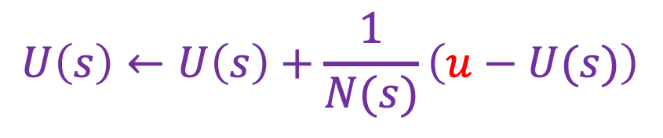
How to Sample Individual $u$
$$U\left(s\right)←U\left(s\right)+\frac{1}{N(s)}\left(u−U(s)\right)$$
Monte Carlo (MC) Method
Temporal-Difference (TD) Method

Slide 28
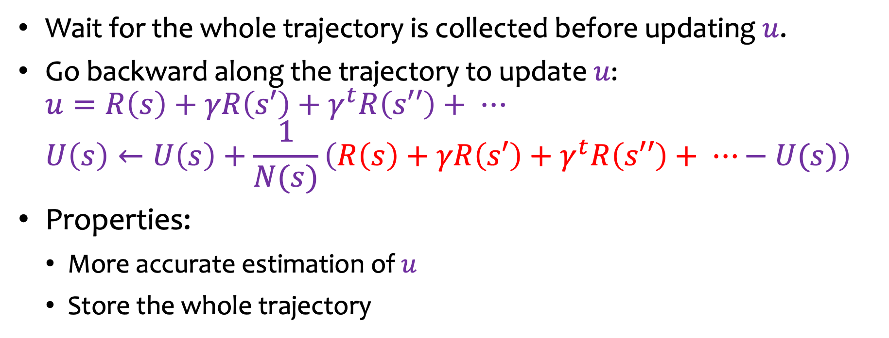
Monte Carlo (MC) Method
Wait for the whole trajectory is collected before updating $u$.
Go backward along the trajectory to update $u$: $u=R\left(s\right)+γR\left(s′\right)+γ^{t}R\left(s′′\right)+ ⋯$ $U\left(s\right)←U\left(s\right)+\frac{1}{N(s)}\left(R\left(s\right)+γR\left(s′\right)+γ^{t}R\left(s′′\right)+ ⋯−U(s)\right)$
Properties:
More accurate estimation of $u$
Store the whole trajectory
Notes:
Problem: relies on storing (collecting) entire trajectory before calculating utility.

Slide 29
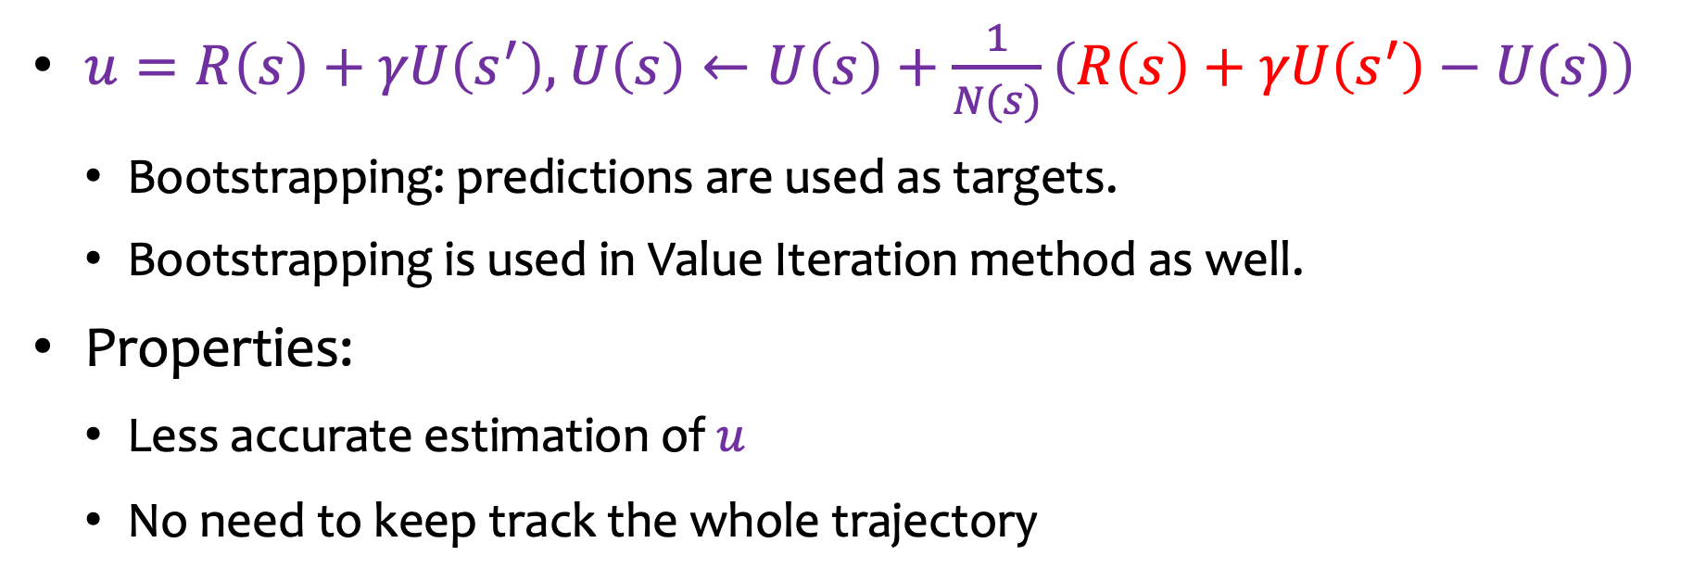
Temporal-Difference (TD) Method
$u=R\left(s\right)+γU\left(s^{′}\right),$ $U\left(s\right)←U\left(s\right)+\frac{1}{N(s)}\left(R\left(s\right)+γU\left(s^{′}\right)−U(s)\right)$
Bootstrapping: predictions are used as targets.
Bootstrapping is used in Value Iteration method as well.
Properties:
Less accurate estimation of $u$
No need to keep track the whole trajectory
Notes:
In order to save memory, use your neighbors estimation (bootstrapping = use predictive value as target value; less accurate, but with enough samples it will eventually converge to correct values).
Reduces number of columns in the table.
You need to collect more samples for TD method: trade space (memory) for time (computation). This is why MC method is still useful because you can use this method when you have limited number of samples but still want faster (more accurate) convergence.
Advanced study: instead of using only the previous value, use previous n values → will cost more memory (space) but as said before it will save time (computational power) by getting accurate results faster (converge faster).
Spectrum (combination of TD + MC) →
TD method --------------------combination----------------------------MC method

Slide 30
Three Tasks in RL
How to choose sampling policies?
How to learn the transition model and the utility from samples?
How to obtain the optimal policy?
Sampling policy
Transition model and Utility
Latest optimal policy

Slide 31
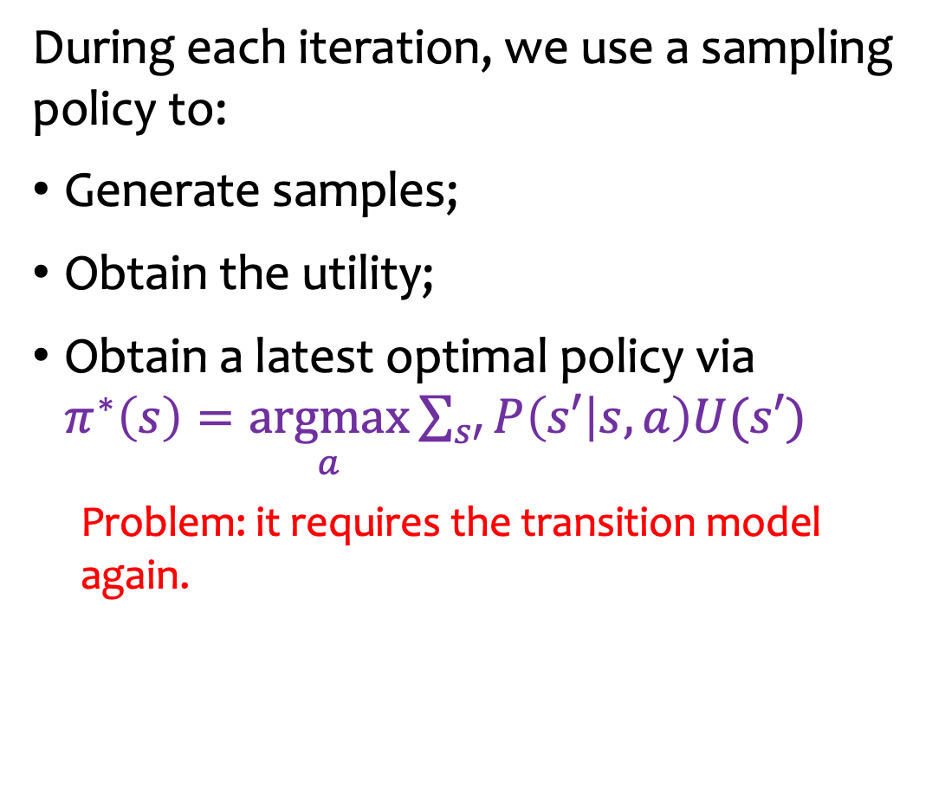
Issue
During each iteration, we use a sampling policy to:
Generate samples;
Obtain the utility;
Obtain a latest optimal policy via $π^{∗}\left(s\right)=\underset{a}{\text{argmax}}{\sum_{s′}{P\left(s′ | s,a\right)U(s′)}}$
Problem: it requires the transition model again.
Sampling policy
Transition model and Utility
Latest optimal policy
Notes:
Now at this point, we know how to sample, and how to obtain utility; now we are ready to use the equation to find optimal policy, but this requires we still consider transition probability, which thus still requires transition model. We need a better model that can determine optimal policy without using transition model and only using the sampling and utility value calculations.

Slide 32
Outline
Introduction
Exploitation and Exploration
Model-Free Utility Learning (problem: still requires transition model even though utility can be determined)
Another Utility Model: Q-Value (revision to model-free utility learning model that does not require transition model)

Slide 33

Q-Value: Another Utility Model
$U\left(s\right)$: an expected utility of a stochastic state sequence starting at $s$ under an optimal policy.
$Q\left(s,a\right)$: an expected utility of a stochastic (state, action) sequence starting at $\left(s,a\right)$ under a policy.

Slide 34
Example
84.7 |  | 92.0 |  | 94.9 |  | +100
84.6 | 90.8 | 87.3 | 94.6 | 91.2 | 95.9
78.1 |  | 91.9 |  | 77.0
85.0 |  |  |  | 73.1 |  | -100
52.5 | 74.8 |  |  | 64.1 | -57.7
45.1 |  |  |  | 46.9
78.8 |  | 53.8 |  | 67.3 |  | -74.0
49.5 | 51.7 | 50.6 | 61.4 | 53.6 | 34.6 | 48.4 | 14.6
55.1 |  | 53.2 |  | 60.6 |  | 1.2
c
b
a
1
2
3
4
Notes:
State-action-sequence just like with the previous model , but now with our sampling we consider not only the start state, but the action taken at that state that gives the utility for the trajectory.

Slide 35
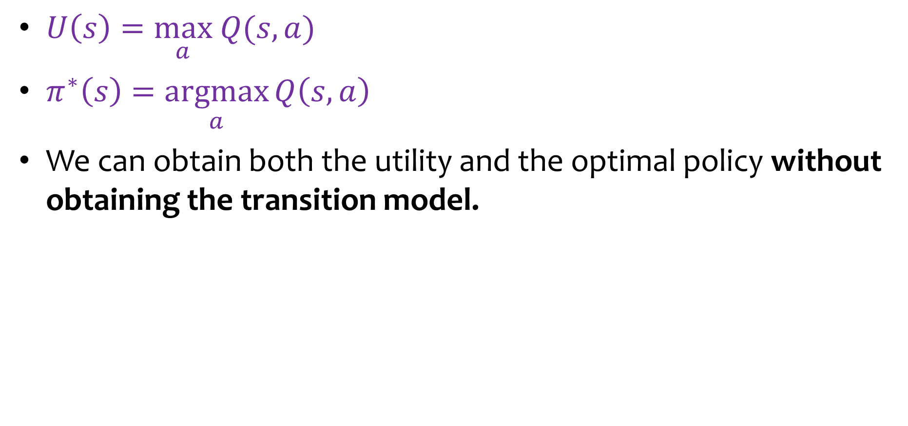
Q-Value Properties under Optimal Policy
$U\left(s\right)=\underset{a}{\text{max}} Q(s,a)$
$π^{∗}\left(s\right)=\underset{a}{\text{arg}\text{max}}{Q\left(s,a\right)}$
We can obtain both the utility and the optimal policy without obtaining the transition model.
Notes:
Note: reward is easy to collect; simply collect the reward during each sample run and keep track of the average reward if it is not a deterministic reward (for example, if reward has probability of being different values each time we arrive at the state to collect the reward). Otherwise, if reward is constant (set or known), then it is very easy to factor in reward into the above equations for determining best policy, which is why he did not include R(s) in the equations above.

Slide 36
How to learn Q-values?

Slide 37

Recall: Learning $U\left(s\right)$
Model-free MC $U\left(s\right)←U\left(s\right)+\frac{1}{N(s)}\left(R\left(s\right)+γR\left(s′\right)+γ^{t}R\left(s′′\right)+ ⋯−U(s)\right)$
Model-free TD $U\left(s\right)←U\left(s\right)+\frac{1}{N(s)}\left(R\left(s\right)+γU\left(s^{′}\right)−U(s)\right)$
Our focus on learning Q(s,a): model-free TD

Slide 38
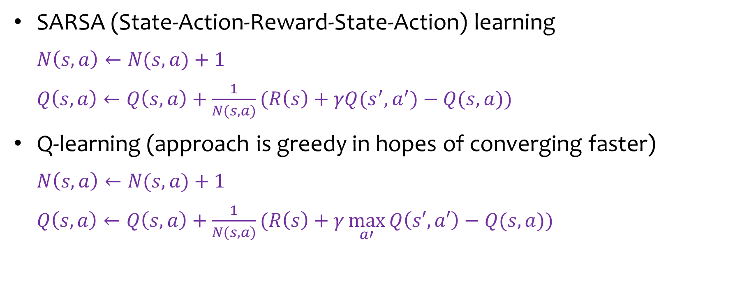
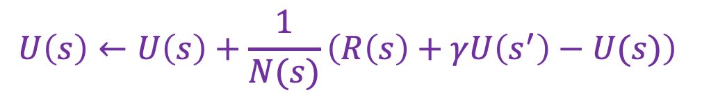
Model-Free TD Methods
$$U\left(s\right)←U\left(s\right)+\frac{1}{N(s)}\left(R\left(s\right)+γU\left(s^{′}\right)−U(s)\right)$$
SARSA (State-Action-Reward-State-Action) learning
$N\left(s,a\right)←N(s,a)$ + 1
$Q\left(s,a\right)←Q\left(s,a\right)+\frac{1}{N(s,a)}(R\left(s\right)+γQ(s^{′},a^{′})−Q(s,a))$
Q-learning (approach is greedy in hopes of converging faster)
$N\left(s,a\right)←N(s,a)\text{ + 1}$
$Q\left(s,a\right)←Q\left(s,a\right)+\frac{1}{N(s,a)}(R\left(s\right)+γ\underset{a′}{\text{max}}{Q\left(s′,a′\right)}−Q(s,a))$
Notes:
Only when you try to explore (random) the next state, then SARSA and Q-Learning may be different because most of the time the max(a’) with Q-Learning is the same as with SARSA which already converges to set next action as current best at the given state.

Slide 39
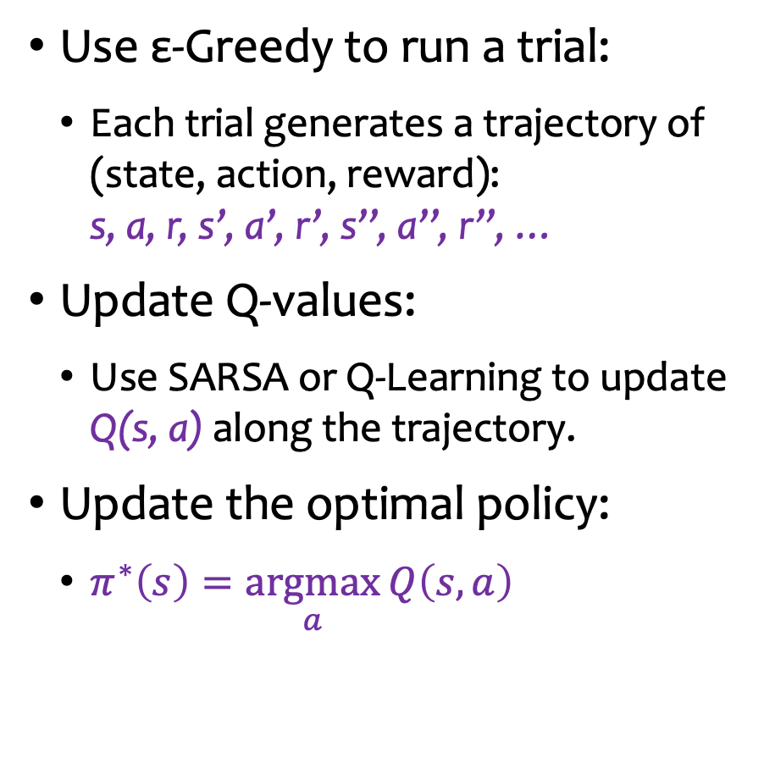
Workflow
Use ε-Greedy to run a trial:
Each trial generates a trajectory of (state, action, reward): s, a, r, s’, a’, r’, s’’, a’’, r’’, …
Update Q-values:
Use SARSA or Q-Learning to update Q(s, a) along the trajectory.
Update the optimal policy:
$π^{∗}\left(s\right)=\underset{a}{\text{argmax}}{Q\left(s,a\right)}$
Sampling policy
ε-Greedy
Q-value update
SARSA or Q-Learning
Latest optimal policy

Slide 40


Example: Initial Optimal Policy
$$γ=1$$
$$ε=0.1$$
$$Q\left(s,a\right)$$
0.0 |  | 0.0 |  | 0.0 |  | +100
0.0 | 0.0 | 0.0 | 0.0 | 0.0 | 0.0
0.0 |  | 0.0 |  | 0.0
0.0 |  |  |  | 0.0 |  | -100
0.0 | 0.0 |  |  | 0.0 | 0.0
0.0 |  |  |  | 0.0
0.0 |  | 0.0 |  | 0.0 |  | 0.0
0.0 | 0.0 | 0.0 | 0.0 | 0.0 | 0.0 | 0.0 | 0.0
0.0 |  | 0.0 |  | 0.0 |  | 0.0
Optimal action: highlighted in red
c
b
a
1
2
3
4
Since all Q-values are zero for any state-action pair, any action at any state is an optimal action.

Slide 41
Example: Initial ε-Greedy Sampling Policy
$$Q\left(s,a\right)$$
0.0 |  | 0.0 |  | 0.0 |  | +100
0.0 | 0.0 | 0.0 | 0.0 | 0.0 | 0.0
0.0 |  | 0.0 |  | 0.0
0.0 |  |  |  | 0.0 |  | -100
0.0 | 0.0 |  |  | 0.0 | 0.0
0.0 |  |  |  | 0.0
0.0 |  | 0.0 |  | 0.0 |  | 0.0
0.0 | 0.0 | 0.0 | 0.0 | 0.0 | 0.0 | 0.0 | 0.0
0.0 |  | 0.0 |  | 0.0 |  | 0.0
c
b
a
1
2
3
4
Due to many optimal action options, the ε-Greedy sampling policy will choose many random actions.
It might take a long time to reach the terminal state to have a complete trial.

Slide 42

Example: An Initial Sampling Trajectory
$$Q\left(s,a\right)$$
0.0 |  | 0.0 |  | 0.0 |  | +100
0.0 | 0.0 | 0.0 | 0.0 | 0.0 | 0.0
0.0 |  | 0.0 |  | 0.0
0.0 |  |  |  | 0.0 |  | -100
0.0 | 0.0 |  |  | 0.0 | 0.0
0.0 |  |  |  | 0.0
0.0 |  | 0.0 |  | 0.0 |  | 0.0
0.0 | 0.0 | 0.0 | 0.0 | 0.0 | 0.0 | 0.0 | 0.0
0.0 |  | 0.0 |  | 0.0 |  | 0.0
c
b
a
1
2
3
4
There are many random actions and some drifting and bouncing-back.

Slide 43


Example: Updated Access Frequency and Q-Values after Some Trials
$$N\left(s,a\right)$$
$$Q\left(s,a\right)$$
14 |  | 10 |  | 14 |  | +100
13 | 384 | 19 | 447 | 14 | 693
22 |  | 20 |  | 20
342 |  |  |  | 250 |  | -100
7 | 11 |  |  | 190 | 15
7 |  |  |  | 14
194 |  | 10 |  | 167 |  | 14
7 | 10 | 147 | 16 | 16 | 13 | 36 | 28
6 |  | 9 |  | 12 |  | 535
45.4 |  | 61.1 |  | 78.9 |  | +100
44.9 | 77.4 | 60.9 | 90.6 | 79.0 | 95.0
28.7 |  | 53.4 |  | 67.6
58.8 |  |  |  | 73.8 |  | -100
19.7 | 35.0 |  |  | 33.9 | -55.8
26.2 |  |  |  | 11.1
35.8 |  | 8.4 |  | 49.1 |  | -81.6
15.4 | 13.5 | 16.4 | 6.1 | -0.9 | 4.2 | 18.7 | -9.7
5.3 |  | -0.0 |  | 8.7 |  | 0.0
c
b
a
1
2
3
4
1
2
3
4

Slide 44
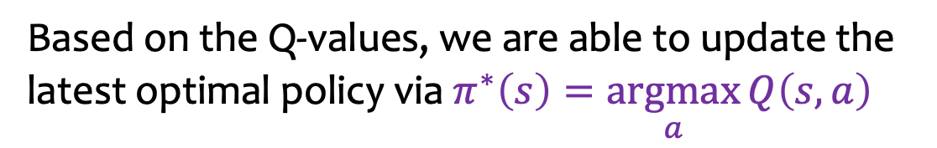
Example: Latest Optimal Policy
$$Q\left(s,a\right)$$
45.4 |  | 61.1 |  | 78.9 |  | +100
44.9 | 77.4 | 60.9 | 90.6 | 79.0 | 95.0
28.7 |  | 53.4 |  | 67.6
58.8 |  |  |  | 73.8 |  | -100
19.7 | 35.0 |  |  | 33.9 | -55.8
26.2 |  |  |  | 11.1
35.8 |  | 8.4 |  | 49.1 |  | -81.6
15.4 | 13.5 | 16.4 | 6.1 | -0.9 | 4.2 | 18.7 | -9.7
5.3 |  | -0.0 |  | 8.7 |  | 0.0
c
b
a
1
2
3
4
Based on the Q-values, we are able to update the latest optimal policy via $π^{∗}\left(s\right)=\underset{a}{\text{argmax}}{Q\left(s,a\right)}$

Slide 45
How does SARSA and Q-Learning update Q-values differently?

Slide 46
Outline
Introduction
Exploitation and Exploration
Model-Free Utility Learning
Another Utility Model: Q-Value
SARSA Illustration

Slide 47
Latest Access Frequency and Q-Values
$$N\left(s,a\right)$$
$$Q\left(s,a\right)$$
6 |  | 3 |  | 1 |  | +100
10 | 5 | 5 | 12 | 0 | 25
11 |  | 3 |  | 1
5 |  |  |  | 9 |  | -100
18 | 9 |  |  | 55 | 2
13 |  |  |  | 4
6 |  | 4 |  | 28 |  | 4
8 | 17 | 3 | 20 | 1 | 8 | 8 | 8
6 |  | 4 |  | 4 |  | 77
-2.4 |  | -1.8 |  | 41.0 |  |  | +100
-2.4 | 16.4 | -1.8 | 60.8 | 0.0 |  | 88.8
-2.4 |  | -1.8 |  | 3.4
-2.9 |  |  |  | 45.8 |  |  | -100
-2.9 | -2.9 |  |  | 12.2 | -101.0 | -101.0
-2.9 |  |  |  | -51.5
-2.6 |  | -1.9 |  | 11.0 |  |  | -101.0
-2.5 | -2.2 | -2.0 | 0.5 | -2.0 |  | -2.1 | -15.0 | -14.9
-2.4 |  | -2.1 |  | -1.9 |  |  | -3.7
c
b
a
1
2
3
4
1
2
3
4
Trajectory: (a2,E,-1) --> (a3,N,-1)< --> (a2,E,-1) --> (a3,N,-1) --> (b3,N,-1)> --> b4
Notes:
Notice in the example there is some drifting.

Slide 48
Updating Access Frequency and Q-Values
$$N\left(s,a\right)$$
$$Q\left(s,a\right)$$
6 |  | 3 |  | 1 |  | +100
10 | 5 | 5 | 12 | 0 | 25
11 |  | 3 |  | 1
5 |  |  |  | 9 |  | -100
18 | 9 |  |  | 55 | 2
13 |  |  |  | 4
6 |  | 4 |  | 28 |  | 4
8 | 17 | 3 | 20 | 1 | 8 | 8 | 8
6 |  | 4 |  | 4 |  | 77
-2.4 |  | -1.8 |  | 41.0 |  |  | +100
-2.4 | 16.4 | -1.8 | 60.8 | 0.0 |  | 88.8
-2.4 |  | -1.8 |  | 3.4
-2.9 |  |  |  | 45.8 |  |  | -100
-2.9 | -2.9 |  |  | 12.2 | -101.0 | -101.0
-2.9 |  |  |  | -51.5
-2.6 |  | -1.9 |  | 11.0 |  |  | -101.0
-2.5 | -2.2 | -2.0 | 0.5 | -2.0 |  | -2.1 | -15.0 | -14.9
-2.4 |  | -2.1 |  | -1.9 |  |  | -3.7
c
b
21
0.95
a
1
2
3
4
1
2
3
4
Trajectory: (a2,E,-1) --> (a3,N,-1)<
N(a2,E) += 1
Q(s,a) ← Q(s,a) + 1/N(s,a) (R(s) + γ Q(s’,a’) − Q(s,a))
Q(a2,E) = 0.5 + 1/21 * (-1 + 1*11.0-0.5) = 0.95
Notes:
N(s,a) == current sample size, and Q(s,a) == current incremental mean.
Notice with Q update, we are using incremental mean.
The trajectory is the sample being collected via E-Greedy (tells which action to take at the given state you are in).
We only use current sample Q collection to update previous Q value (TD method).

Slide 49
Updating Access Frequency and Q-Values
$$N\left(s,a\right)$$
$$Q\left(s,a\right)$$
6 |  | 3 |  | 1 |  | +100
10 | 5 | 5 | 12 | 0 | 25
11 |  | 3 |  | 1
5 |  |  |  | 9 |  | -100
18 | 9 |  |  | 55 | 2
13 |  |  |  | 4
6 |  | 4 |  | 28 |  | 4
8 | 17 | 3 | 21 | 1 | 8 | 8 | 8
6 |  | 4 |  | 4 |  | 77
-2.4 |  | -1.8 |  | 41.0 |  |  | +100
-2.4 | 16.4 | -1.8 | 60.8 | 0.0 |  | 88.8
-2.4 |  | -1.8 |  | 3.4
-2.9 |  |  |  | 45.8 |  |  | -100
-2.9 | -2.9 |  |  | 12.2 | -101.0 | -101.0
-2.9 |  |  |  | -51.5
-2.6 |  | -1.9 |  | 11.0 |  |  | -101.0
-2.5 | -2.2 | -2.0 | 0.95 | -2.0 |  | -2.1 | -15.0 | -14.9
-2.4 |  | -2.1 |  | -1.9 |  |  | -3.7
c
b
29
10.6
a
1
2
3
4
1
2
3
4
Trajectory: (a2,E,-1) --> (a3,N,-1)< --> (a2,E,-1)
N(a3,N) += 1
Q(s,a) ← Q(s,a) + 1/N(s,a) (R(s) + γ Q(s’,a’) − Q(s,a))
Q(a3,N) = 11.0 + 1/29 * (-1 + 1*0.95-11.0) = 10.6

Slide 50
Updating Access Frequency and Q-Values
$$N\left(s,a\right)$$
$$Q\left(s,a\right)$$
6 |  | 3 |  | 1 |  | +100
10 | 5 | 5 | 12 | 0 | 25
11 |  | 3 |  | 1
5 |  |  |  | 9 |  | -100
18 | 9 |  |  | 55 | 2
13 |  |  |  | 4
6 |  | 4 |  | 29 |  | 4
8 | 17 | 3 | 21 | 1 | 8 | 8 | 8
6 |  | 4 |  | 4 |  | 77
-2.4 |  | -1.8 |  | 41.0 |  |  | +100
-2.4 | 16.4 | -1.8 | 60.8 | 0.0 |  | 88.8
-2.4 |  | -1.8 |  | 3.4
-2.9 |  |  |  | 45.8 |  |  | -100
-2.9 | -2.9 |  |  | 12.2 | -101.0 | -101.0
-2.9 |  |  |  | -51.5
-2.6 |  | -1.9 |  | 10.6 |  |  | -101.0
-2.5 | -2.2 | -2.0 | 0.95 | -2.0 |  | -2.1 | -15.0 | -14.9
-2.4 |  | -2.1 |  | -1.9 |  |  | -3.7
c
b
22
1.34
a
1
2
3
4
1
2
3
4
Trajectory: (a2,E,-1) --> (a3,N,-1)< --> (a2,E,-1) --> (a3,N,-1)
N(a2,E) += 1
Q(s,a) ← Q(s,a) + 1/N(s,a) (R(s) + γ Q(s’,a’) − Q(s,a))
Q(a2,E) = 0.95 + 1/22 * (-1 + 1*10.6-0.95) = 1.34

Slide 51
Updating Access Frequency and Q-Values
$$N\left(s,a\right)$$
$$Q\left(s,a\right)$$
6 |  | 3 |  | 1 |  | +100
10 | 5 | 5 | 12 | 0 | 25
11 |  | 3 |  | 1
5 |  |  |  | 9 |  | -100
18 | 9 |  |  | 55 | 2
13 |  |  |  | 4
6 |  | 4 |  | 29 |  | 4
8 | 17 | 3 | 22 | 1 | 8 | 8 | 8
6 |  | 4 |  | 4 |  | 77
-2.4 |  | -1.8 |  | 41.0 |  |  | +100
-2.4 | 16.4 | -1.8 | 60.8 | 0.0 |  | 88.8
-2.4 |  | -1.8 |  | 3.4
-2.9 |  |  |  | 45.8 |  |  | -100
-2.9 | -2.9 |  |  | 12.2 | -101.0 | -101.0
-2.9 |  |  |  | -51.5
-2.6 |  | -1.9 |  | 10.6 |  |  | -101.0
-2.5 | -2.2 | -2.0 | 1.34 | -2.0 |  | -2.1 | -15.0 | -14.9
-2.4 |  | -2.1 |  | -1.9 |  |  | -3.7
c
b
30
11.7
a
1
2
3
4
1
2
3
4
Trajectory: (a2,E,-1) --> (a3,N,-1)< --> (a2,E,-1) --> (a3,N,-1) --> (b3,N,-1)>
N(a3,N) += 1
Q(s,a) ← Q(s,a) + 1/N(s,a) (R(s) + γ Q(s’,a’) − Q(s,a))
Q(a3,N) = 10.6 + 1/30 * (-1 + 1*45.8-10.6) = 11.7

Slide 52
Updating Access Frequency (# samples) and Q-Values
$$N\left(s,a\right)$$
$$Q\left(s,a\right)$$
6 |  | 3 |  | 1 |  | +100
10 | 5 | 5 | 12 | 0 | 25
11 |  | 3 |  | 1
5 |  |  |  | 9 |  | -100
18 | 9 |  |  | 55 | 2
13 |  |  |  | 4
6 |  | 4 |  | 30 |  | 4
8 | 17 | 3 | 22 | 1 | 8 | 8 | 8
6 |  | 4 |  | 4 |  | 77
-2.4 |  | -1.8 |  | 41.0 |  |  | +100
-2.4 | 16.4 | -1.8 | 60.8 | 0.0 |  | 88.8
-2.4 |  | -1.8 |  | 3.4
-2.9 |  |  |  | 45.8 |  |  | -100
-2.9 | -2.9 |  |  | 12.2 | -101.0 | -101.0
-2.9 |  |  |  | -51.5
-2.6 |  | -1.9 |  | 11.7 |  |  | -101.0
-2.5 | -2.2 | -2.0 | 1.34 | -2.0 |  | -2.1 | -15.0 | -14.9
-2.4 |  | -2.1 |  | -1.9 |  |  | -3.7
c
10
31.1
b
a
1
2
3
4
1
2
3
4
Trajectory: (a2,E,-1) --> (a3,N,-1)< --> (a2,E,-1) --> (a3,N,-1) --> (b3,N,-1)> --> b4
N(b3,N) += 1
Q(s,a) ← Q(s,a) + 1/N(s,a) (R(s) + γ Q(s’,a’) − Q(s,a))
Q(b3,N) = 45.8 + 1/10 * (-1 + 1*(-100)- 45.8) = 31.1
Notes:
Note sampling policy and starting position for samples will affect if and how fast this algorithm converges to optimal policy.

Slide 53
Latest Optimal Policy
$$N\left(s,a\right)$$
$$Q\left(s,a\right)$$
6 |  | 3 |  | 1 |  | +100
10 | 5 | 5 | 12 | 0 | 25
11 |  | 3 |  | 1
5 |  |  |  | 10 |  | -100
18 | 9 |  |  | 55 | 2
13 |  |  |  | 4
6 |  | 4 |  | 30 |  | 4
8 | 17 | 3 | 22 | 1 | 8 | 8 | 8
6 |  | 4 |  | 4 |  | 77
-2.4 |  | -1.8 |  | 41.0 |  |  | +100
-2.4 | 16.4 | -1.8 | 60.8 | 0.0 |  | 88.8
-2.4 |  | -1.8 |  | 3.4
-2.9 |  |  |  | 31.1 |  |  | -100
-2.9 | -2.9 |  |  | 12.2 | -101.0 | -101.0
-2.9 |  |  |  | -51.5
-2.6 |  | -1.9 |  | 11.7 |  |  | -101.0
-2.5 | -2.2 | -2.0 | 1.34 | -2.0 |  | -2.1 | -15.0 | -14.9
-2.4 |  | -2.1 |  | -1.9 |  |  | -3.7
c
b
a
1
2
3
4
1
2
3
4
Trajectory: (a2,E,-1) --> (a3,N,-1)< --> (a2,E,-1) --> (a3,N,-1) --> (b3,N,-1)> --> b4

Slide 54
Outline
Introduction
Exploitation and Exploration
Model-Free Utility Learning
Another Utility Model: Q-Value
SARSA Illustration
Q Learning Illustration

Slide 55
Latest Access Frequency and Q-Values
$$N\left(s,a\right)$$
$$Q\left(s,a\right)$$
6 |  | 3 |  | 1 |  | +100
10 | 5 | 5 | 12 | 0 | 25
11 |  | 3 |  | 1
5 |  |  |  | 9 |  | -100
18 | 9 |  |  | 55 | 2
13 |  |  |  | 4
6 |  | 4 |  | 28 |  | 4
8 | 17 | 3 | 20 | 1 | 8 | 8 | 8
6 |  | 4 |  | 4 |  | 77
-2.4 |  | -1.8 |  | 41.0 |  |  | +100
-2.4 | 16.4 | -1.8 | 60.8 | 0.0 |  | 88.8
-2.4 |  | -1.8 |  | 3.4
-2.9 |  |  |  | 45.8 |  |  | -100
-2.9 | -2.9 |  |  | 12.2 | -101.0 | -101.0
-2.9 |  |  |  | -51.5
-2.6 |  | -1.9 |  | 11.0 |  |  | -101.0
-2.5 | -2.2 | -2.0 | 0.5 | -2.0 |  | -2.1 | -15.0 | -14.9
-2.4 |  | -2.1 |  | -1.9 |  |  | -3.7
c
b
a
1
2
3
4
1
2
3
4
Trajectory: (a2,E,-1) --> (a3,N,-1) --> (b3,E,-1)* --> b4
Notes:
Difference from SARSA learning: when we update previous state-action pair, do not use the action from current state sample, rather, use the current best action at the current state.
Thus Q Learning is a more greedy approach.

Slide 56
Updating Access Frequency and Q-Values
$$N\left(s,a\right)$$
$$Q\left(s,a\right)$$
6 |  | 3 |  | 1 |  | +100
10 | 5 | 5 | 12 | 0 | 25
11 |  | 3 |  | 1
5 |  |  |  | 9 |  | -100
18 | 9 |  |  | 55 | 2
13 |  |  |  | 4
6 |  | 4 |  | 28 |  | 4
8 | 17 | 3 | 20 | 1 | 8 | 8 | 8
6 |  | 4 |  | 4 |  | 77
-2.4 |  | -1.8 |  | 41.0 |  |  | +100
-2.4 | 16.4 | -1.8 | 60.8 | 0.0 |  | 88.8
-2.4 |  | -1.8 |  | 3.4
-2.9 |  |  |  | 45.8 |  |  | -100
-2.9 | -2.9 |  |  | 12.2 | -101.0 | -101.0
-2.9 |  |  |  | -51.5
-2.6 |  | -1.9 |  | 11.0 |  |  | -101.0
-2.5 | -2.2 | -2.0 | 0.5 | -2.0 |  | -2.1 | -15.0 | -14.9
-2.4 |  | -2.1 |  | -1.9 |  |  | -3.7
c
b
21
0.95
a
1
2
3
4
1
2
3
4
Trajectory: (a2,E,-1) --> (a3,N,-1)
N(a2,E) += 1
Q(s,a) ← Q(s,a) + 1/N(s,a) (R(s) + γ max_{a’} Q(s’,a’) − Q(s,a))
Q(a2,E) = 0.5 + 1/21 * (-1 + 1*11.0-0.5) = 0.95
Notes:
for both SARSA and Q Learning, do not forget to UPDATE N(s,a) FIRST, BEFORE updating Q(s,a).

Slide 57
Updating Access Frequency and Q-Values
$$N\left(s,a\right)$$
$$Q\left(s,a\right)$$
6 |  | 3 |  | 1 |  | +100
10 | 5 | 5 | 12 | 0 | 25
11 |  | 3 |  | 1
5 |  |  |  | 9 |  | -100
18 | 9 |  |  | 55 | 2
13 |  |  |  | 4
6 |  | 4 |  | 28 |  | 4
8 | 17 | 3 | 21 | 1 | 8 | 8 | 8
6 |  | 4 |  | 4 |  | 77
-2.4 |  | -1.8 |  | 41.0 |  |  | +100
-2.4 | 16.4 | -1.8 | 60.8 | 0.0 |  | 88.8
-2.4 |  | -1.8 |  | 3.4
-2.9 |  |  |  | 45.8 |  |  | -100
-2.9 | -2.9 |  |  | 12.2 | -101.0 | -101.0
-2.9 |  |  |  | -51.5
-2.6 |  | -1.9 |  | 11.0 |  |  | -101.0
-2.5 | -2.2 | -2.0 | 0.95 | -2.0 |  | -2.1 | -15.0 | -14.9
-2.4 |  | -2.1 |  | -1.9 |  |  | -3.7
c
b
29
12.2
a
1
2
3
4
1
2
3
4
Trajectory: (a2,E,-1) --> (a3,N,-1) --> (b3,E,-1)*
N(a3,N) += 1
Q(s,a) ← Q(s,a) + 1/N(s,a) (R(s) + γ max_{a’} Q(s’,a’) − Q(s,a))
Q(a3,N) = 11.0 + 1/29 * (-1 + 1*45.8-11.0) = 12.2
Notes:
Special note: the (b3, E, -1)* is a random action from E-Greedy sampling.
Research question: could we adapt E-Greedy sampling so that when random sampling is selected, we make it less random by causing the random action to consider the Q-Value (for example, if a Q value is too small, then do not distribute the probability that the action will be randomly selected to that action but rather distribute the random action to all of the other actions).

Slide 58
Updating Access Frequency and Q-Values
$$N\left(s,a\right)$$
$$Q\left(s,a\right)$$
6 |  | 3 |  | 1 |  | +100
10 | 5 | 5 | 12 | 0 | 25
11 |  | 3 |  | 1
5 |  |  |  | 9 |  | -100
18 | 9 |  |  | 55 | 2
13 |  |  |  | 4
6 |  | 4 |  | 29 |  | 4
8 | 17 | 3 | 21 | 1 | 8 | 8 | 8
6 |  | 4 |  | 4 |  | 77
-2.4 |  | -1.8 |  | 41.0 |  |  | +100
-2.4 | 16.4 | -1.8 | 60.8 | 0.0 |  | 88.8
-2.4 |  | -1.8 |  | 3.4
-2.9 |  |  |  | 45.8 |  |  | -100
-2.9 | -2.9 |  |  | 12.2 | -101.0 | -101.0
-2.9 |  |  |  | -51.5
-2.6 |  | -1.9 |  | 12.2 |  |  | -101.0
-2.5 | -2.2 | -2.0 | 0.95 | -2.0 |  | -2.1 | -15.0 | -14.9
-2.4 |  | -2.1 |  | -1.9 |  |  | -3.7
c
3
-101.0
b
a
1
2
3
4
1
2
3
4
Trajectory: (a2,E,-1) --> (a3,N,-1) --> (b3,E,-1)* --> b4
N(b3,E) += 1
Q(s,a) ← Q(s,a) + 1/N(s,a) (R(s) + γ max_{a’} Q(s’,a’) − Q(s,a))
Q(b3,E) = -101.0 + 1/3 * (-1 + 1*(-100) + 101.0) = -101.0

Slide 59
Difference between SARSA and Q-Learning
Q-learning backs up the best Q-value from the state reached in the observed transition.
SARSA waits until an action is actually taken and backs up the Q-value for that action.
Now, for a greedy agent that always takes the action with best Q-value, the two algorithms are identical.
When exploration is happening, however, they differ significantly.
Q-learning uses the best Q-value, it pays no attention to the actual policy being followed.

Slide 60
Summary
Use ε-Greedy to run a trial:
Each trial generates a trajectory of (state, action, reward): s, a, r, s’, a’, r’, s’’, a’’, r’’, …
Update Q-values:
Use SARSA or Q-Learning to update Q(s, a) along the trajectory.
Update the optimal policy:
$π^{∗}\left(s\right)=\underset{a}{\text{argmax}}{Q\left(s,a\right)}$
Sampling policy
ε-Greedy
Q-value update
SARSA or Q-Learning
Latest optimal policy
Notes:
With MDP, when you have transition model, then value iteration algorithm will converge much faster on the optimal policy.
Note: coding using Q-values (because you do not have transition model) versus utility values using value iteration takes about the same amount of effort in terms of coding; its just Q-values will converge slower and require more memory since you need to keep track of Q-value (a form of utility derived from sampling) for each action at each state.
Special topic: if you had a transition model at each state that was changing, then just reset N and resample to find the new optimal policy.
Q-Learning is being used in Autonomous Vehicles (and in Simulation environments such as video games).
Challenge: discretizing the state space (making the continuous real world discrete); but the more fine grained number of states and actions at each state you have, the more accuracy you have, but the more memory and computational power is needed. We need to balance how much we discretize the state space with the tradeoff of gaining or losing accuracy at the cost of requiring or not requiring as much memory and computation respectively.
This is why incremental mean and TD method (or TD + MC method is so useful) because we already have a challenging amount of memory and computational power necessary to make autonomous vehicles meet a high enough QoS.

